Slide 1
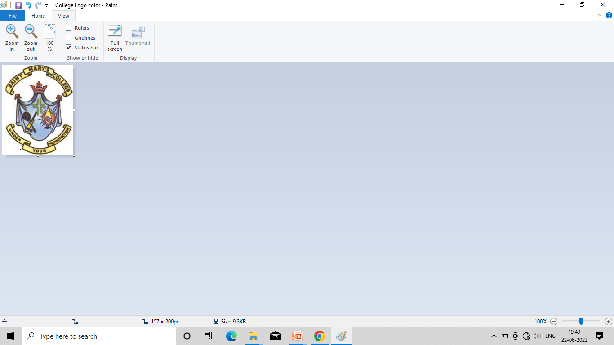

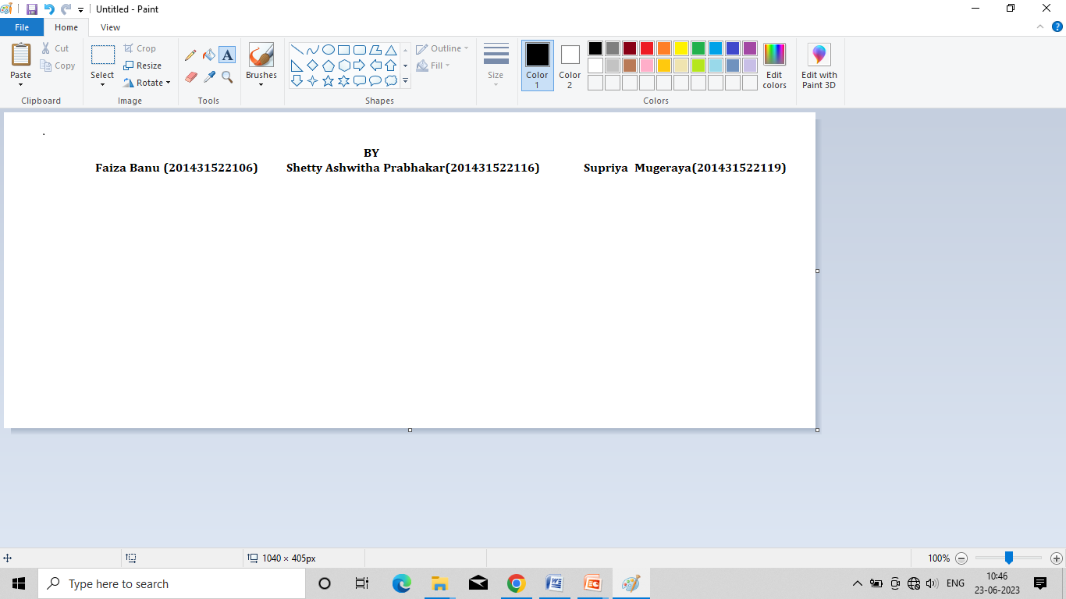
“CoolLens” BACHELOR OF COMPUTER APPLICATIONS OF UNIVERSITY
PROJECT REPORT ON
INTERNAL GUIDE
Prof. Mrs. Divyashree B
Department of Computer Science
St Mary’s College,Shirva
DEPARTMENT OF COMPUTER SCIENCE
ST.MARY’S COLLEGE ,SHIRVA-57411
2022-2023

Slide 2
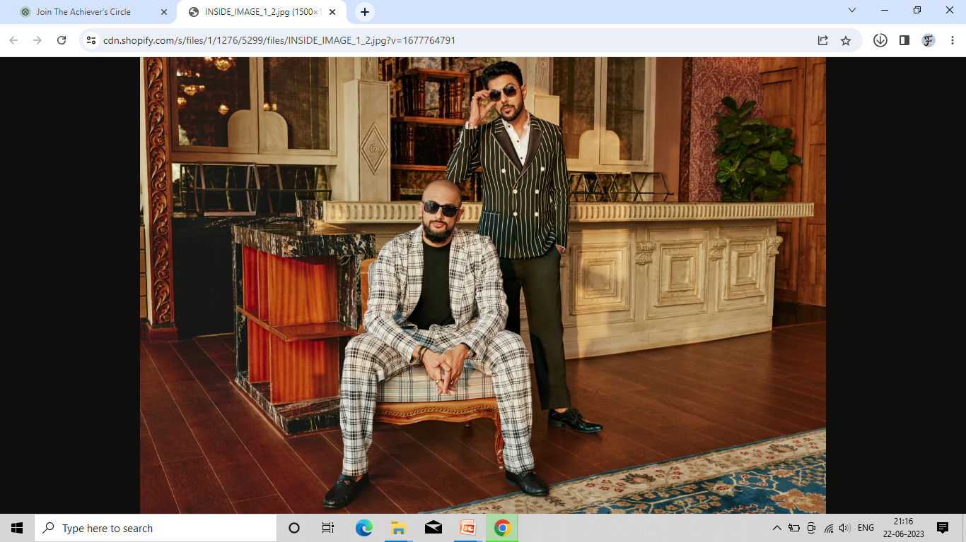
CoolLens
New Way to see

Slide 3

SYNOPSIS

Slide 4
Title of the project:- CoolLens
Main objective of the project:
The main objective of the eyewear website is to provide a convenient and hassle-free shopping experience for customers who are looking to purchase eyeglasses or sunglasses.
The website aims to offer a wide selection of frames from well-known brands, including designer brands, and provide customers with detailed product descriptions and high-quality images to help them make informed decisions.
Trusted – tension free and reliable delivery of the product.

Slide 5
Structure of the project
Problem Analysis
Maintaining the data manually to keep track of information of every customer of every item, its sale and purchase depending upon the area of the same is very time consuming and it may cause inefficiency, inaccuracy and it is also difficult to manage those documents.

Slide 6
Project category:
This project is a web based application that comes under the Relational Database Management System (RDBMS).
Languages/ Frameworks used:
Front End: HTML, CSS, JavaScript, Python.
Back End: SQLite, Django.

Slide 7
MODULES: The program consists of following modules:
Administrator module:
Category management
Seller Management
Product management
Vendors/Seller:
Registration module
Product management
Report Module

Slide 8
End users/customers:
Registration module
Search module
Purchase module
Cart module
Payment module
Feedback module
Cancel module

Slide 9
Software requirements specification:
Operating system: Windows, linux, mac, unix
Server: Django server
Scripting language: HTML, CSS, JavaScript
Database server: SQLlite3
Integrated Development Environment (IDE): Visual studio code
Front End: HTML, CSS, Java Script, Python
Back End: Django, SQLite

Slide 10
LIMITATIONS:
Internet connection required.
Inability on virtual Try on Frames.
Return and Exchange policy.
Basic computer knowledge required.

Slide 11
LITERATURE SURVEY

Slide 12
Python:
Python is an interpreted high-level programming language.
Python can run equally on different platforms such as Windows, Linux, UNIX, and Mac etc. So, we can say that Python is a portable language.
Python is an object-oriented language. It supports the creation and manipulation of objects, which can help organize code and make it easier to maintain.
Python is dynamically typed, meaning that variables don't need to be declared before use, and their type can change at runtime.
The indentation in Python is very important. Python uses indentation to indicate a block of code.
Python syntax is very easy, as compared to other popular languages.

Slide 13
Django:
Django is a free and open-source web application framework.
Django is extremely fast.
Django can be used for almost any kind of project.
It also helps to prevent common security issues.
Django supports the RDBMS like Mysql, Oracle etc.
It has a built-in admin interface which makes it easy to work with it.
Django is a high-level Python web framework that enables rapid development of secure and maintainable websites.

Slide 14
JavaScript:
JavaScript(JS) is a dynamic computer programming language.
It is most commonly used as part of web browsers, whose implementations allow client-side scripts to interact with the user, control the browser, communicate asynchronously, and alter the document content that is displayed.
It is also being used in server-side programming, game development and the creation of desktop and mobile applications.
JavaScript's syntax was inspired by Java's and is relatively easy to learn compared to other popular languages like C++.
Open and cross-platform.

Slide 15
HTML5:
HTML stands for Hyper Text Mark-up Language. HTML documents are also called Web Pages.
It is a language which can be easily understood and can be modified.
It is a flexible way to design web pages along with the text.
Links can also be added to the web pages so it helps the readers to browse the information of their interest.
In comparison to other web programming languages on the market, HTML is one of the most user-friendly search engines.

Slide 16
CSS:
CSS is a style sheet language used to describe the presentation semantics (that is, the look and formatting) of a document written in a mark-up language (Style defines how to display HTML elements).
CSS save time that is we can write CSS once and then reuse same sheet in the multiple HTML pages.
External Style Sheets are stored in CSS files.
CSS has much wider array of attribute than HTML.

Slide 17
SQLite3:
SQLite is a compact library.
SQLite is the most used database engine in the world.
SQL is a database querying language and SQLite is a database (RDBMS)which uses SQL specifications.
Sqlite is a very lightweight database engine, with a small library size(typically less than 1MB)
Sqlite is available on many platforms, including linux,macOS and windows.
Sqlite stores all of the data in a single file on the file system,which make it easy to copy or backup the daytabase.

Slide 18
SOFTWARE REQUIREMENT SPECIFICATION

Slide 19
Chapter-3 Software requirement specification
Introduction:
Software Requirements Specification (SRS) document is a document that completely describes 'WHAT' the software must do without describing how the software will do it.

Slide 20
Purpose:
The purpose of this SRS is to specify the requirements of the web based software application, which is an online eyewear shopping system.
This Software Requirements Specification provides a complete description of all the functions and specifications of modules.
The basic purpose of the SRS is to bridge the gap between the client and the developer.
Another important purpose of developing the SRS is to help clients to understand their own needs.
There are several problems in gathering the requirements.
The final goal of the requirement is to produce a high quality and stable SRS.

Slide 21
User Characteristics :
There are 3 kinds of users for the proposed system.
Administrators :
Administrator is the owner of this software, he can do anything in the software like add product, delete products, managing products etc.
Vendors/Sellers :
Vendors/Sellers will add their products to the database, which will be seen in the website to the end users or say customers who can buy the products by selecting the one they need. Vendors will have the special privileges than the end users, and have ability to manage the products added by them.
End Users/Customers:
The end user will be the one who visits the website and buys products online from the ones added by the Vendor.

Slide 22
General Constraints:
The main constraint here would be checking the genuineness of the buyer, which is not always possible.
There can be security risks involved.
The developed system should run under any platform (Unix, Linux, Mac, Windows etc..) that contains a web browser which supports JavaScript
Assumptions and Dependencies:
The details related to the product, customer, payment and service transaction provided manually.
Administrator is created in the system already.
Roles and tasks are predefined.

Slide 23
Software Interfaces:
Operating System: Unix, Linux, Mac, Windows etc...
Development tool: Python, JavaScript.
Data Base: SQLITE.
Hardware Requirements Specification: Processor: Pentium- II Or Higher Hard Disk Space: 40 GB (Min) RAM Memory: 4GB(Min)
Communication Interface:
The Website Order system shall send an email confirmation to the customer that the items they ordered will be delivered to the shipping address along with user identification.

Slide 24
Functional Requirements:
Customer profile module:
Here once the customer is logged in his details will be stored and his details will be displayed in his profile.
Product module:
In this product module customers can view all the Eyewear item list with name, image, description etc.
Product category module:
The Eyewear items records are divided in categories. The customer can filter category wise.

Slide 25
Contact module:
In the contact module the customer can directly contact the website Admin customer and can view replies in the mail.
Tax module:
The GST tax varies for the products, here the admin can set tax for each product.

Slide 26
Design Constraints: There are few constraints that the system should follow,they are:
All the inputs should be checked for validation and messages should be given for the improper data. The invalid data are to be ignored and error messages should be given.
Details provided by the vendor during his sign up should be stored in database.
While adding the products to the system, mandatory fields must be checked for validation whether the vendor has filled appropriate data in these mandatory fields. If not, proper error message should be displayed or else the data is to be stored in database for later retrieval.
All mandatory fields should be filled by customer, while buying the items from the cart.

Slide 27
Performance Requirements:
Should have a good memory space.
Should be error-free.
Should handle large amounts of data.
Safety Requirements:
Backups can be done regularly.

Slide 28
SYSTEM DESIGN

Slide 29
Chapter-4 System Design
NTRODUCTION:
Design is processes through which requirements are translated into a representation of the software. The purpose of the designing phase is to plan a solution for the problem specified by the requirements document. The design activity often results in three separate outputs:
Architecture Design
High Level Design
Detailed Design
System Design is a solution a “How to” approach to the creation of a new system. The importance phase is composed of several steps.

Slide 30
System Context Diagram
The System Context Diagram or Context Flow Diagram
CFD is a top level dataflow diagram. The System Context Diagram or Context Flow Diagram (CFD) describes the external entities acting on the system. In context diagram the entire system is treated as a single process.

Slide 31
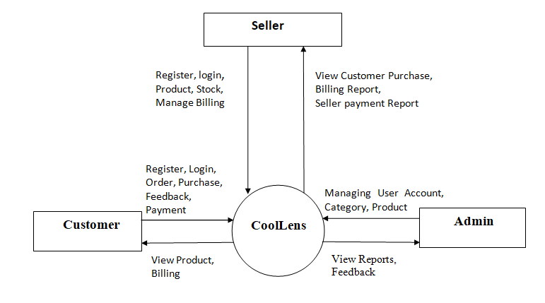

Slide 32
Data Flow Diagram
A Data Flow Diagram (DFD) is a graphical representation of the “flow” of the data through an information System. It is common practice for designer to draw a context level DFD first which shows the interaction between the system and outside entities.

Slide 33
Rules for Constructing DFD
Process should be named for easy understanding.
The direction of flow, top to bottom and from left to right should be specified.
The direction of flow should not allow any kind of loops.

Slide 34

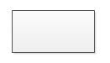
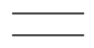
The DFD uses four symbols, and explained below
Symbol | Description
 | The circle or bubble represents a process. A process is named, and each process is represented by a named circle.
 | The source or sink is represented as a rectangular box. The source or sink is the net originator or the consumer of the data that flows in the system.
 | The arrow represents the flow of data through the system. The labeled arrows enter or leave the bubbles
 | The database is represented with the open box symbol

Slide 35
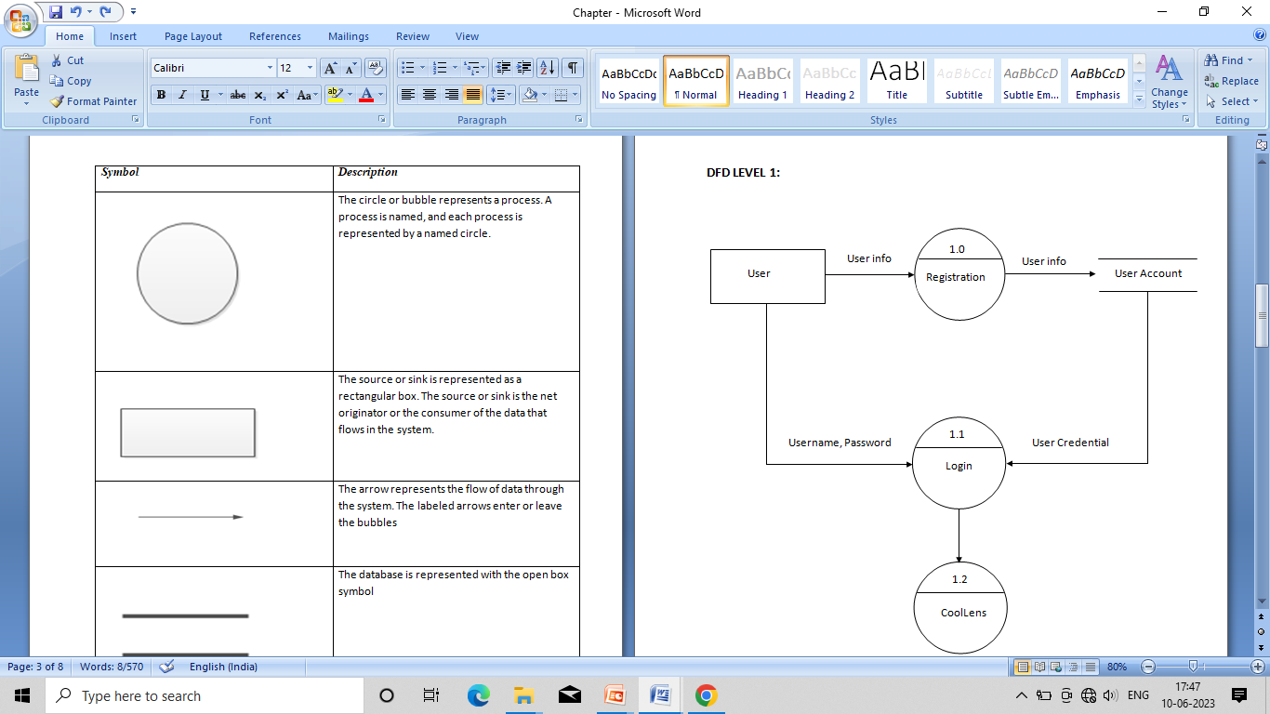

Slide 36
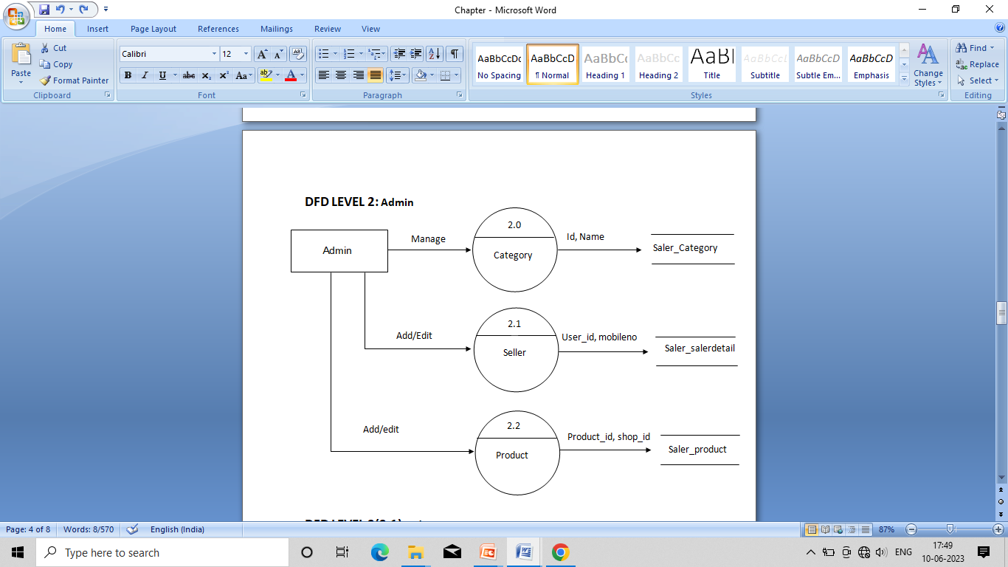

Slide 37
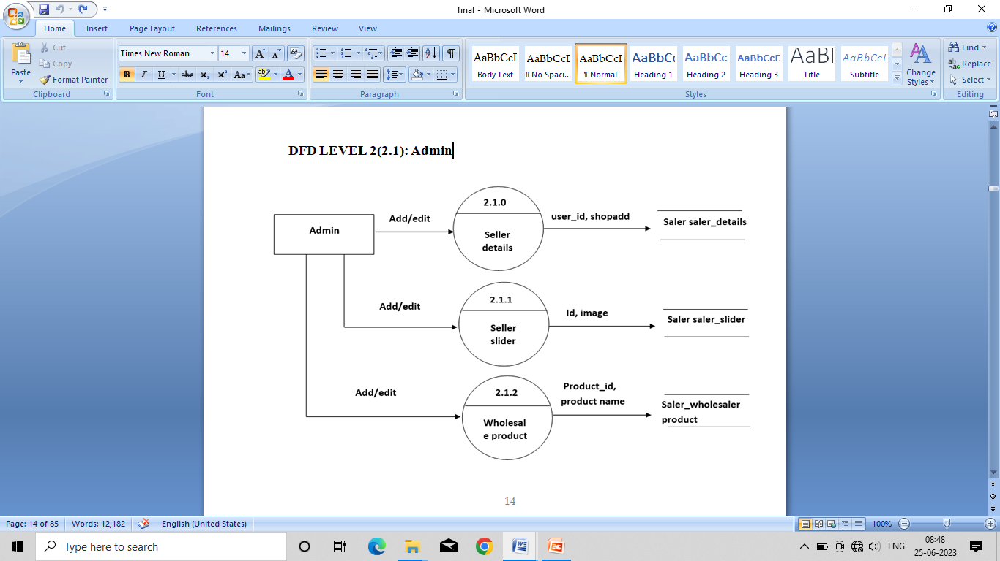

Slide 38
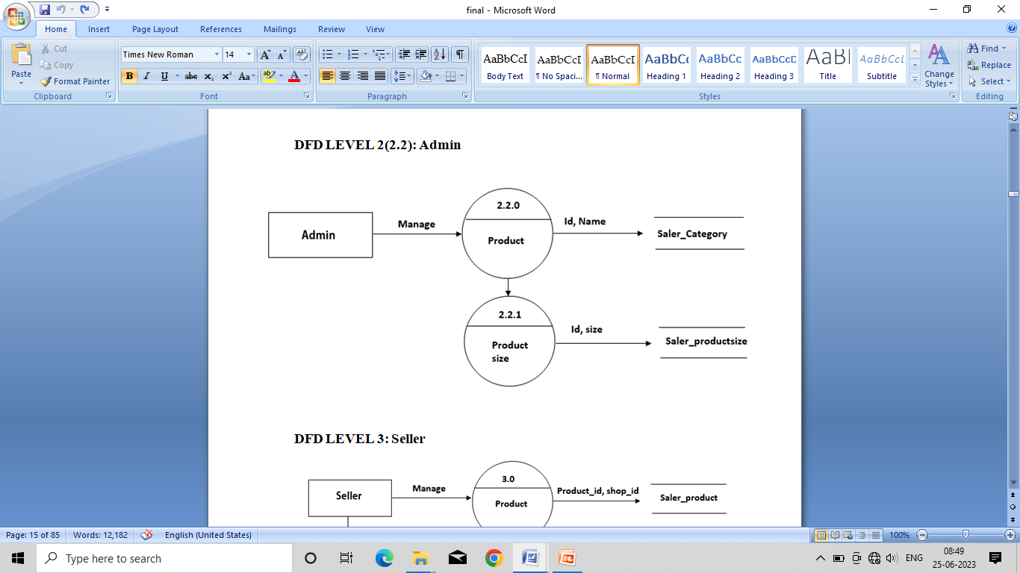

Slide 39
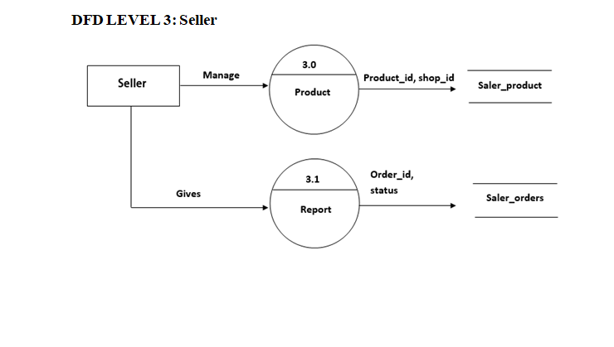

Slide 40
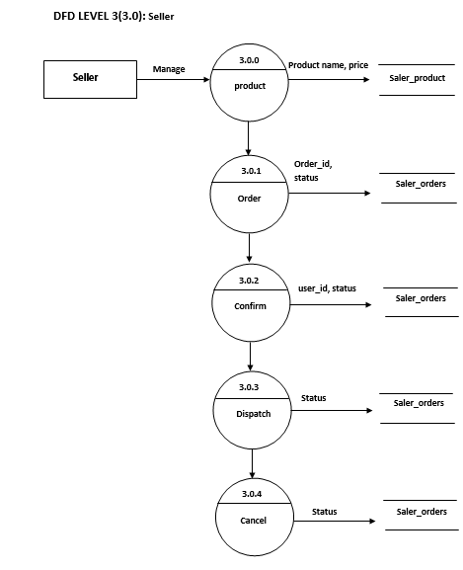

Slide 41
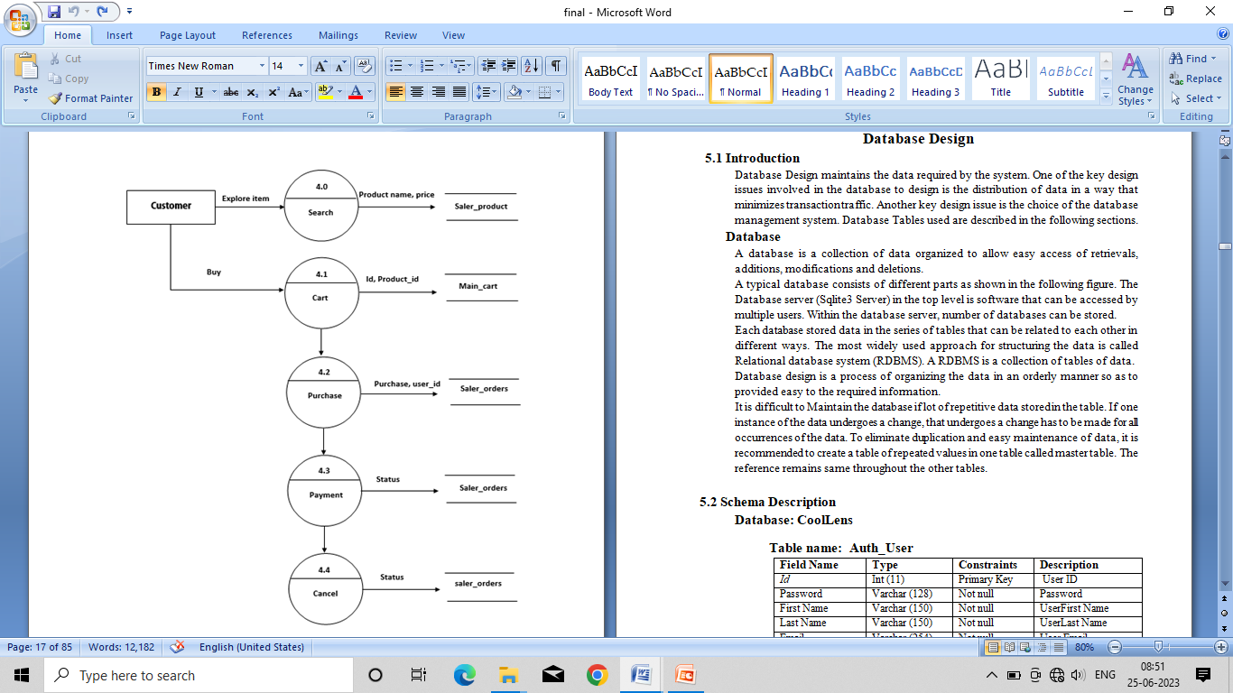
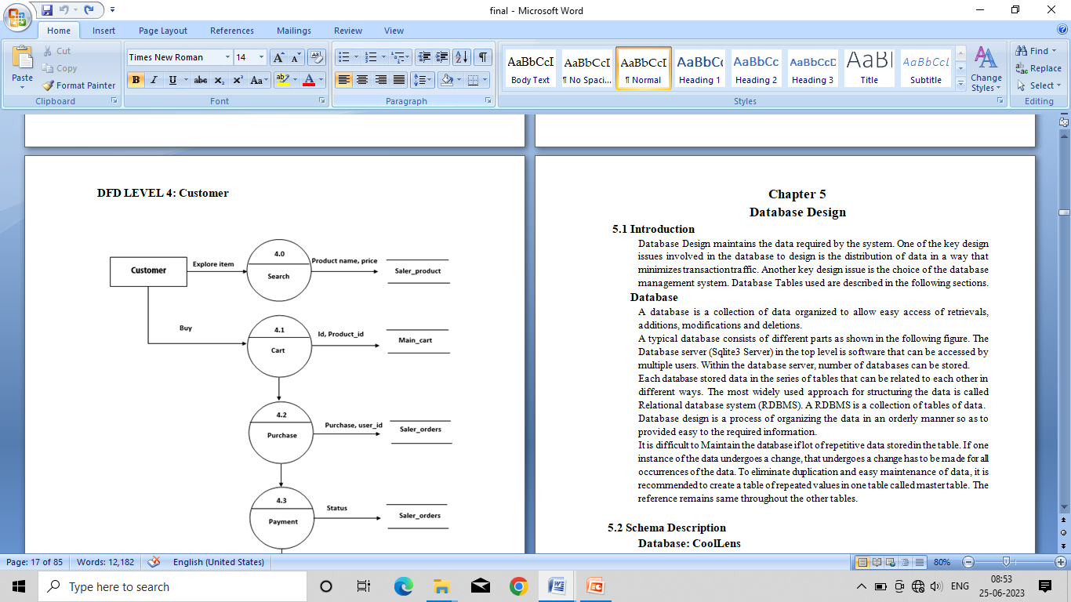

Slide 42
DATABASE DESIGN

Slide 43
Chapter 5 Database Design
Introduction
Database Design maintains the data required by the system.
The goal good database design is to achieve optical performance, accuracy, integrity, and scalability while meeting the specific requirements of an application or system.
Database
A database is a collection of data organized to allow easy access of retrievals, additions, modifications and deletions.
A typical database consists of different parts as shown in the following figure. The Database server (Sqlite3 Server) in the top level software that can be accessed by multiple users. Within the database server, number of database can be stored.
Database Tables used are described in the following sections.

Slide 44
Schema Description
Database: db.sqlite3
Table name: Auth_User
Field Name | Type | Constraints | Description
Id | Int (11) | Primary Key | User ID
Password | Varchar (128) | Not null | Password
First Name | Varchar (150) | Not null | UserFirst Name
Last Name | Varchar (150) | Not null | UserLast Name
Email | Varchar (254) | Not null | User Email
Is_ staff | bool | Not null | Staff
Is_ Active | bool | Not null | Activation
Date_ joined | Date Time | Not null | Date joined
Last_login | Date Time | Not null | Last login
Is_ superuser | bool | Not null | Is superuser
Username | Varchar (150) | Not null | Username

Slide 45
Table name: django_admin_log
Field Name | Type | Constraints | Description
Id | int (11) | Primary Key | ID
Action_time | Date time | Not null | Action_time
Object_id | Text | null | Object_id
Object_repr | varchar (200) | Not null | Object_repr
Change_message | Text | Not null | Change_message
Content_type_id | Int | null | Content_type_id
User_id | Int | Not null | User_id
Action_flag | int | Not null | Action_flag

Slide 46
Table name: Main_userDetail
Field Name | Type | Constraints | Description
User _Id | int (11) | Primary Key | User ID
Dob | Date | null | Dob
Photo | varchar (100) | Not null | Photo
Mobile | varchar (10) | Not null | Mobile Number
Alternate_mobile number | Varchar (10) | Not null | Alternate_mobile number
address | text | Not null | address
pincode | Varchar(6) | Not null | pincode
landmark | Varchar(500) | Null | landmark
locality | Varchar(100) | Null | locality
city | Varchar(100) | Null | city
state | Varchar(50) | Null | state
sex | Varchar(6) | null | sex

Slide 47
Table name: saler_product
Field Name | Type | Constraints | Description
Product_id | int(11) | Primary Key | Product ID
Categoryid | int(11) | null | Category ID
shop_id | int(11) | Not null | Shop ID
Product_name | varchar (35) | Not null | Product name
Description | Text | Not null | Product description
GST | int(11) | Not null | GST
Price | int | Not null | Product Price
Subcategory | Varchar(50) | Not null | Subcategory ID
Image | varchar (35) | Not null | Product Image
Price_not | int | Not null | Price_not
Pub_date | date | Not null | Pub_date

Slide 48
Table name: saler_orders
Field Name | Type | Constraints | Description
id | int (11) | Primary Key | ID
User_id | int | Foreign key | User_id
Order_id | varchar (50) | Not null | Order_id
Products | varchar (50) | Not null | Products
Saler | Varchar (100) | Not null | Saler
Status | varchar (15) | Not null | Status
size | Varchar (50) | null | size

Slide 49
Table name: seller_detail
Field Name | Type | Constraints | Description
User_id | int (11) | Primary Key | Company ID
photo | varchar (500) | Not null | Seller’s photo
mobile | Varchar(10) | Not null | Seller mobile
Gst_number | varchar (15) | Not null | Seller gstnumber
Shop_name | varchar (500) | Not null | Seller shop_name
Alternate_mobile | varchar (10) | Not null | Seller alternate mobile number
Shop_address | text | Not null | Seller address
pincode | varchar (6) | Not null | Seller pincode
landmark | varchar (500) | Not null | Seller landmark
locality | varchar (100) | Not null | Seller Iocality
City | varchar (100) | Not null | Seller city
State | varchar (50) | Not null | Seller state

Slide 50
Table name: saler_category
Field Name | Type | Constraints | Description
id | int (11) | Primary Key | Company ID
name | varchar (50) | Not null | Category name
Sub_categories | text | Not null | Sub Category name

Slide 51
Table name: main_cart
Field Name | Type | Constraints | Description
id | int (11) | Primary Key | id
Product_id | varchar (100) | Not null | Product_id
number | integer | Not null | number
User_id | integer | Foreign key | User_id
Product_size | varchar (20) | Not null | Product_size

Slide 52
Tablename: saler_productreview
Field Name | Type | Constraints | Description
id | int (11) | Primary Key | id
review | Text | Not null | review
Time | Datetime | Not null | Time
Product_id | integer | Foreign key | Product_id
User_id | integer | Foreign key | User_id

Slide 53
Entity Relationship diagram:
ER diagram is a graphical representation used to visualize the structure of a database system.
It helps in understanding the relationships between the system and how they are connected.

Slide 54
Symbols and Notations:
Entity
Relationship
Attribute

Slide 55
Weak Entity
Weak Entity Relationship
Multivalued Attribute

Slide 56
Key attribute
Composite Attribute

Slide 57
Enties:
Entities are objects or concepts that represent important data. They are typically nouns. E.g. costumer, supervisor, location, or promotion.
Strong Entities: Strong Entities exist independently from other entity types.
Weak Entities: Weak Entities depend on some other entity type.
Associative Entities: Associative Entities are entities that associate the instances of one or more entity types.

Slide 58
Relationship:
A relationship describes relations between entities. Relationship is represented using diamond.
There are three type of relationship that exist between entities.
Strong Relationship: Strong Relationship are meaningful associations between or among entities. They are usually verbs, e.g. assign, associate, or track. A relationship provides useful information that could not be discerned with just the entity types.
Weak Relationships: Weak Relationship or Identifying Relationship, are connection that exist between a weak entity types and its owner.

Slide 59
Attribute:
An Attribute describes a property or characteristics of an entity. For example, Name, Age, Address etc. can be attributes of a Student. An attribute is represented using ellipse.
Attributes are characteristics of either an entity. A many-to- many relationship, or A one-to-one relationship.
Multivalued Attributes: Multivalued Attributes whose value can be calculated from related attribute values.
Key Attribute: Key Attribute represents the main characteristic of an entity it is used to represent primary key ellipse with underlying lines represent key attribute.
Composite Attribute: An attribute can also have their own attribute, These attribute are known as composite attribute.

Slide 60
Keys:
Primary Key: Primary key is a uniquely identify each column in the table.
Foreign Key: Foreign Key is used to point to a Primary Key of another table.

Slide 61
ER diagram
ER.docx

Slide 62
Detailed Design

Slide 63
Chapter 6 Detailed Design
Chapter 6 Detailed Design
Introduction
The detailed design we decide the internal logic for the module, which implement the given specification. Detailed design is one of the levels of the Design process for software items detailed design, which is also known as logic design, involves the internal sign of the module and how the specification of the module can be satisfied.
The first step before the detailed design or code for a module can be developed is that the specification of the module be given precisely. Once the module is precisely specified, the external logic for the module that will implement the given identification can be decided.

Slide 64
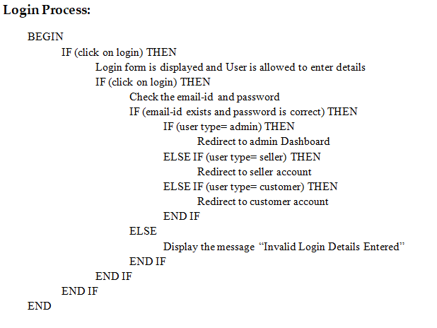
6.2 Structured English

Slide 65
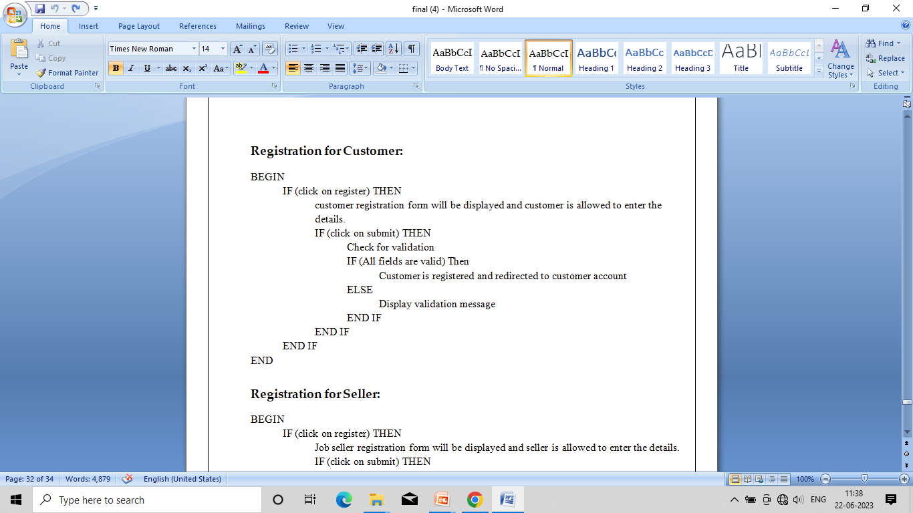

Slide 66
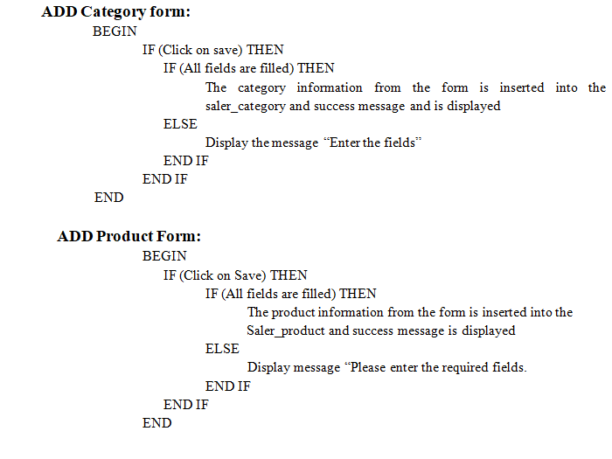

Slide 67
TESTING

Slide 68
Chapter – 8
Testing
Introduction:
Testing is the process of detecting the errors or evaluating a system to ensure that it functions correctly and meets the specified requirements.
Testing is an essential part of the software development life cycle and helps identify defects or error ,ensuring quality and reliability of the software.
Level of Testing:
Unit Testing
Integrated testing
System Testing
User Acceptance Testing
Validation testing
Output testing

Slide 69
Unit Testing
Testing of an individual software component or module is termed as Unit Testing. It is typically done by the programmer and not by testers, as it requires detailed knowledge of the internal program design and code.
Integrated Testing
Testing of all integrated modules to verify the combined functionality after integration is termed as Integration Testing.
System Testing
Under System Testing technique, the entire system is tested as per the requirements. It is a Black-box type Testing that is based on overall requirement specifications and covers all the combined parts of a system.

Slide 70
Validation Testing
Validation testing is a software testing process that is performed to evaluate a system or software application during or at the end of the development cycle to ensure that it satisfies the specified requirements.
Output Testing
Output testing, also known as output validation testing, is a type of software testing that focuses on verifying the accuracy, correctness, and integrity of the output produced by a software application or system.
During output testing, the actual outputs produced by the system are compared against the expected outputs.

Slide 71
User Acceptance Testing
It refers to a phase of software testing where the system or software is evaluated by end users or stakeholders to determine whether it meets their requirements and is acceptable for deployment.
Acceptance testing is performed with realistic data of the client to demonstrate that the software is working satisfactory.

Slide 72
ERROR | DESCRIPTION | CORRECTION | OUTPUT
Integrity Error | Read/write Permission not given to the website folder | Read/Write Permission was set | As Excepted
Index error | Index list out of range | The value was entered within the range | As Excepted
Template Syntax error | Syntax error while rendering | Url pattern was set | As Excepted
Import Error | Occurred when the installed module was not imported | Module was imported | As Excepted
Page not found error | Occurs when Url of particular page was not mapped | Set the correct Path | As Excepted
Module not found error | Occurred when the module crispy forms were not installed | Module was install using python package | As Excepted
Value for error | Occurred when payment mode was not checked | Corrected by selecting payment mode | As Excepted

Slide 73
Test cases:
Customer Registration:
Serial No. | Condition To be Tested | Test Data | Expected Output | Remarks
1 | If any field in the form is empty. | Value of form fields. | Alert the user to enter all the fields and then proceed. | SUCCESSFUL
2 | If Customer Name contains other than characters. | Customer Name | Entered Customer Name should contain alphabets | SUCCESSFUL
3 | If Customer Name field is empty. | Customer Name | Alert the user to enter the fields by displaying “Customer Name should not be empty” | SUCCESSFUL
4 | If Email ID is invalid. | Email ID | Please include an ‘@’ in the email address. Email ID is missing an ‘@’. | SUCCESSFUL
5 | If Email ID field is empty. | Email ID | Alert the user to enter the fields by displaying “Email ID should not be empty” | SUCCESSFUL

Slide 74
6 | If Contact No. contains other than numeric values. | Contact No. | Contact Number should contain 10 digits numeric value… | SUCCESSFUL
7 | If Contact No. field is empty. | Contact No. | Alert the user to enter the fields by displaying “Contact No. should not be empty” | SUCCESSFUL
8 | If Password is less than 8 characters. | Password | Password should be at least 8 characters. | SUCCESSFUL
9 | If Password field is empty. | Password | Alert the user to enter the fields by displaying “Password. should not be empty” | SUCCESSFUL
10 | If password and confirm password does not match | Password and password | Alert the user to Password and Confirm Password not matching... | SUCCESSFUL
11 | If all fields are entered. | All mandatory fields. | Alert - Customer Registration done successfully... | SUCCESSFUL

Slide 75
Customer login:
Serial No. | Condition To be Tested | Test Data | Expected Output | Remarks
1 | If any field in the form is empty. | Value of form fields. | Alert the user to enter all the fields and then proceed. | SUCCESSFUL
2 | If Email ID/Phone No and password is not valid. | Email ID/Password | You have entered invalid login credentials. | SUCCESSFUL
3 | If all fields are entered. | All mandatory fields. | Logged in successfully. | SUCCESSFUL

Slide 76
Customer change password:
Serial No. | Condition to be tested | Test Data | Expected output | Remarks
1 | If any field in the form is empty. | Value of form fields. | Alert the user to enter all the fields and then proceed. | SUCCESSFUL
2 | Password is less than 8 characters. | Password | Password should be at least 8 characters. | SUCCESSFUL
3 | If password and confirm password does not match. | Password and Confirm Password | Password and confirm password are not matching. | SUCCESSFUL
4 | If all fields are entered. | All mandatory fields. | Password updated successfully. | SUCCESSFUL

Slide 77
Customer forgot password:
Serial No. | Condition to be tested | Test Data | Expected output | Remarks
1 | If Email ID is no entered. | Email ID | Email Id should not be empty | SUCCESSFUL
2 | If Email ID is invalid. | Email ID | Please include an ‘@’ in the email address. Email ID is missing an ‘@’. | SUCCESSFUL
3 | If Email ID is valid. | Email ID | We have sent password recovery mail to your Registered Mail ID.. | SUCCESSFUL

Slide 78
Admin login:
Serial No. | Condition to be tested | Test Data | Expected output | Remarks
1 | If any field in the form is empty. | Value of form fields. | Alert the user to enter all the fields and then proceed. | SUCCESSFUL
2 | If Email ID/Phone No and password are not valid. | Email ID/Phone Number and Password | You have entered invalid login credentials. | SUCCESSFUL
3 | If all fields are entered. | All mandatory fields. | Logged in successfully. | SUCCESSFUL

Slide 79
Add Category:
Serial No. | Condition To be Tested | Test Data | Expected Output | Remarks
1 | If any field in the form is empty. | Value of form fields. | Alert the user to enter all the fields and then proceed. | SUCCESSFUL
2 | If Category Type field is empty. | category type | Alert the user to enter the fields by displaying “Category Type should not be empty” | SUCCESSFUL
3 | If Subcategory Type field is empty. | Subcategory type | Alert the user to enter the fields by displaying “Subcategory Type should not be empty” | SUCCESSFUL
5 | If all fields are entered. | All mandatory fields. | Record inserted successfully | SUCCESSFUL

Slide 80
Seller Register:
Serial No. | Condition To be Tested | Test Data | Expected Output | Remarks
1 | If any field in the form is empty. | Value of form fields. | Alert the user to enter all the fields and then proceed. | SUCCESSFUL
2 | If Company/Shop Name field is empty. | company name | Alert the user to enter the fields by displaying “Company Name should not be empty” | SUCCESSFUL
3 | If Email ID is invalid. | Email ID | Please include an ‘@’ in the email address. Email ID is missing an ‘@’. | SUCCESSFUL
4 | If Email ID field is empty. | Email ID | Alert the user to enter the fields by displaying “Email ID should not be empty” | SUCCESSFUL
5 | If contact No. not equal to 10 digits | Contact No | Alert the user to enter the fields by displaying “Contact No. should have 10 digit. | SUCCESSFUL

Slide 81
6 | If Contact No. field is empty. | Contact No | Alert the user to enter the fields by displaying “Contact No. should not be empty” | SUCCESSFUL
7 | If Password field is empty. | Password | Alert the user to enter the fields by displaying “Password should not be empty” | SUCCESSFUL
8 | If Password less than 8 characters | Password | Alert the user to enter Password more than 8 characters x | SUCCESSFUL
9 | If Password and Confirm password does not match. | Password | Password and confirm password are not matching. | SUCCESSFUL
10 | If GST is empty. | GST | Alert the user to enter the fields by displaying “GST should not be empty” | SUCCESSFUL
11 | If all fields are entered. | All mandatory fields. | Company record inserted successfully. | SUCCESSFUL

Slide 82
Snapshots

Slide 83
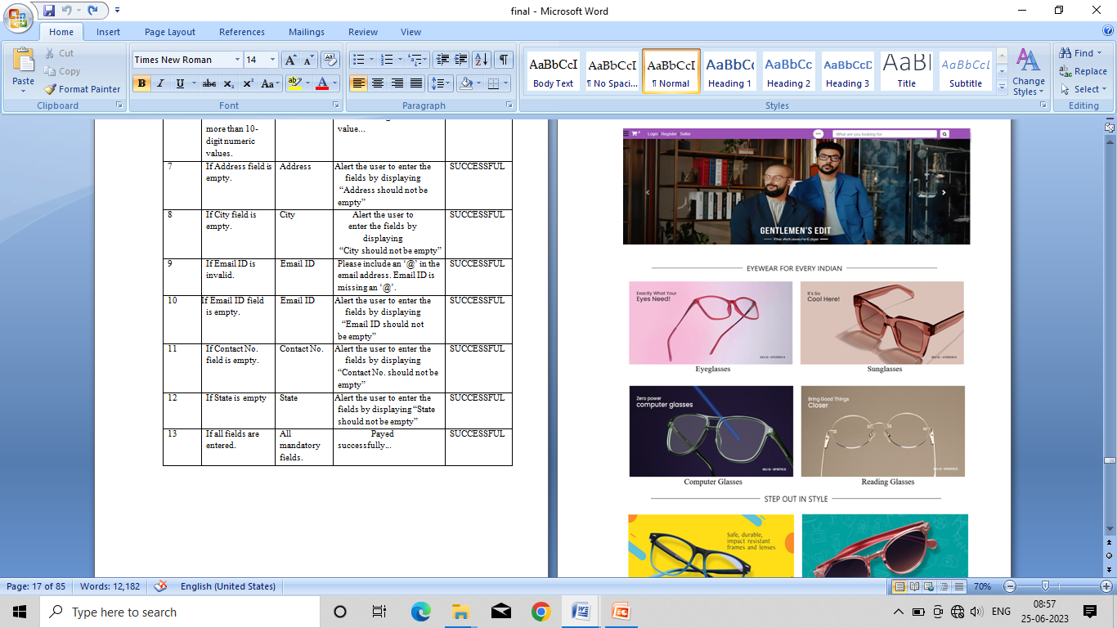
Home Page

Slide 84
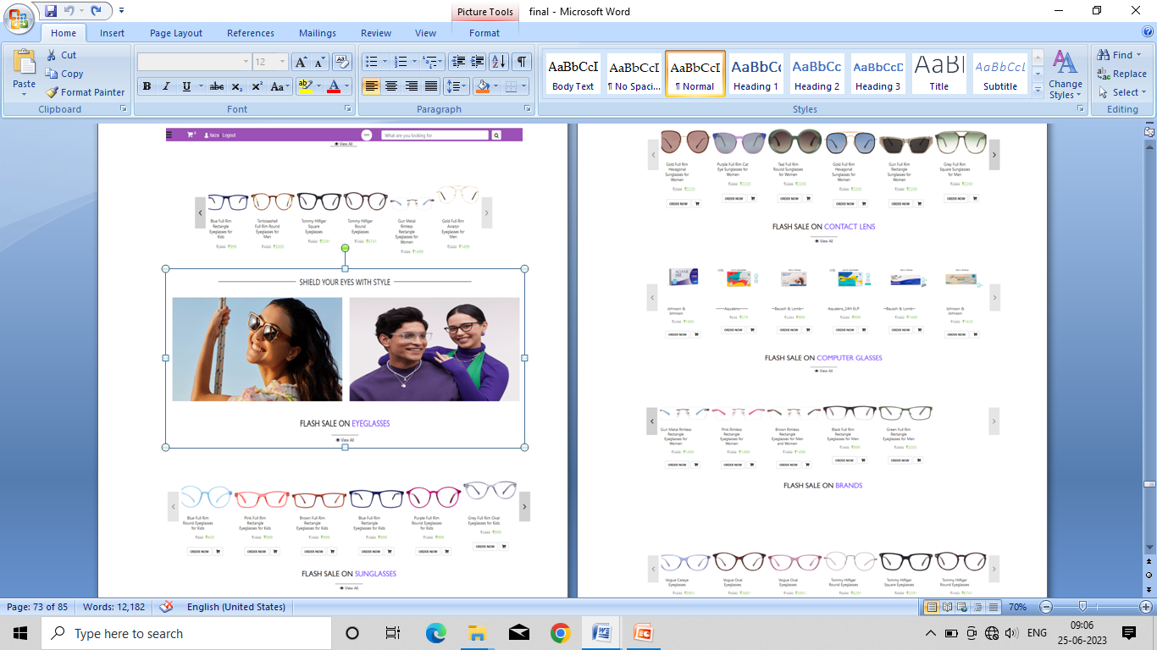

Slide 85
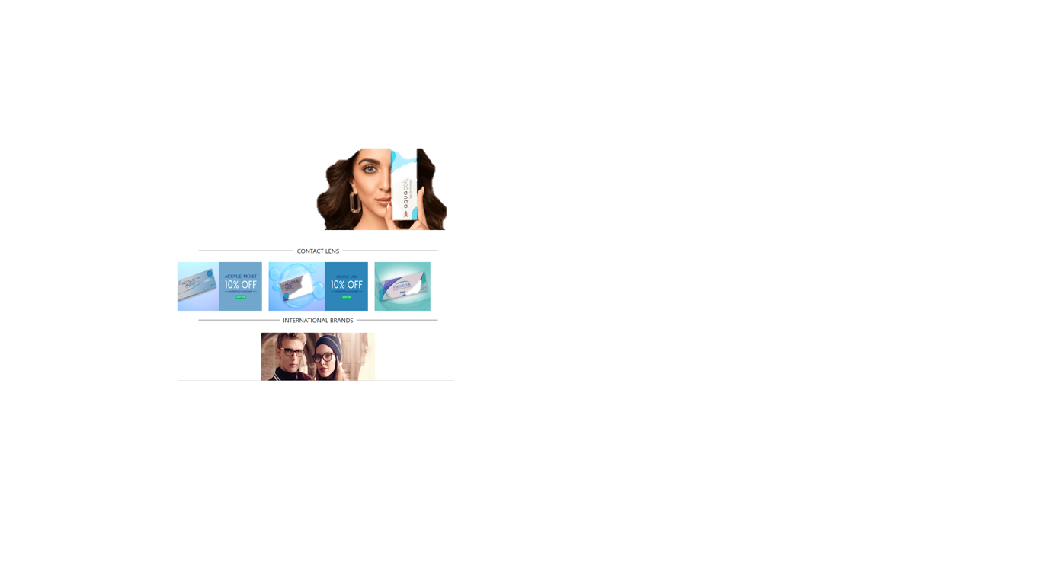

Slide 86
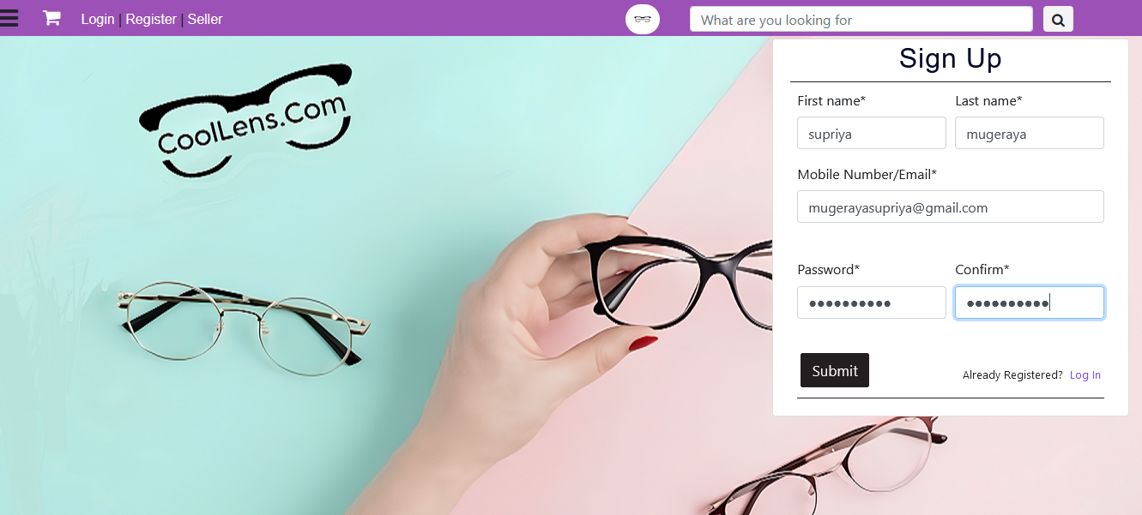
Customer Registration form

Slide 87
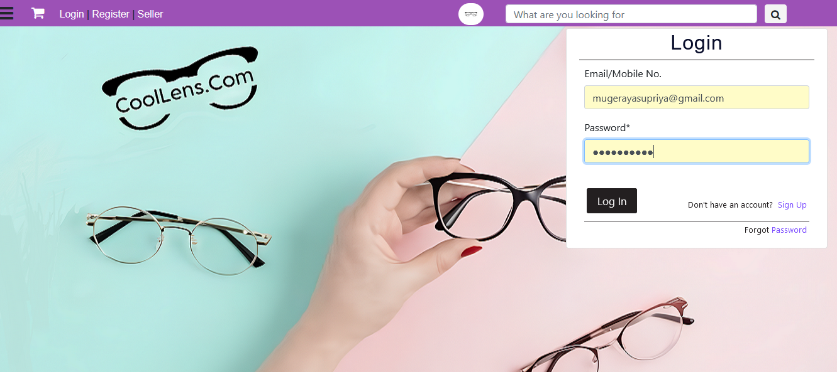
Customer Login form

Slide 88
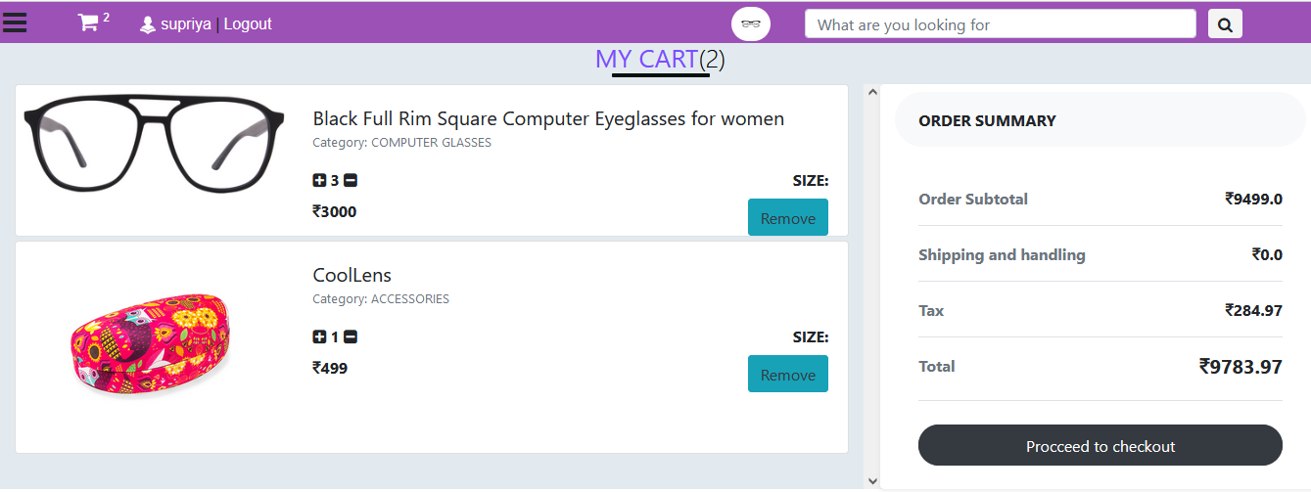
Cart

Slide 89
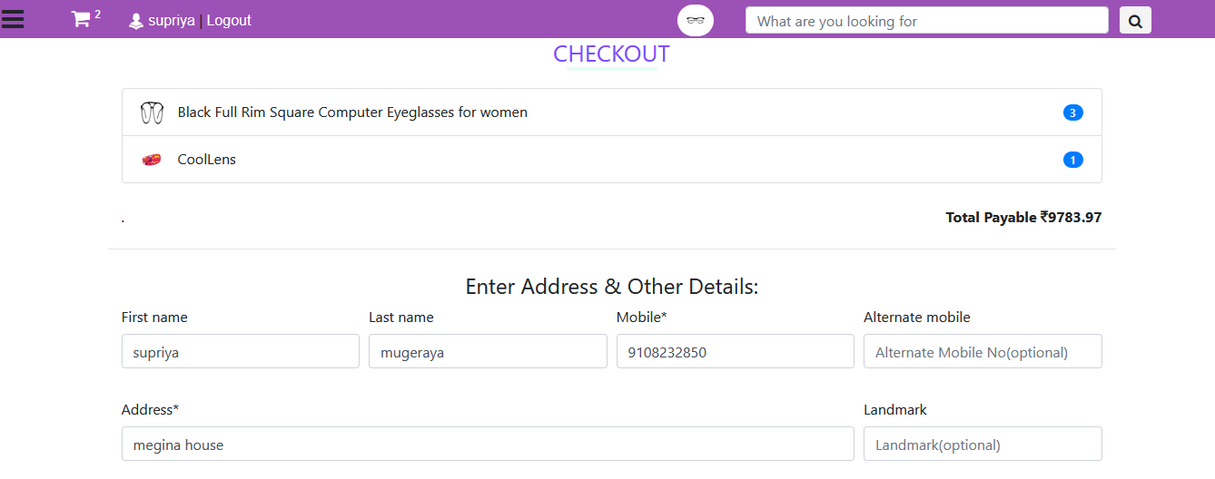
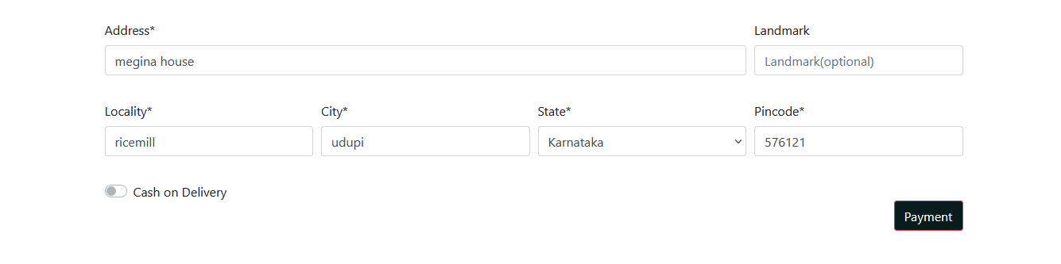
Checkout/Payment Page

Slide 90
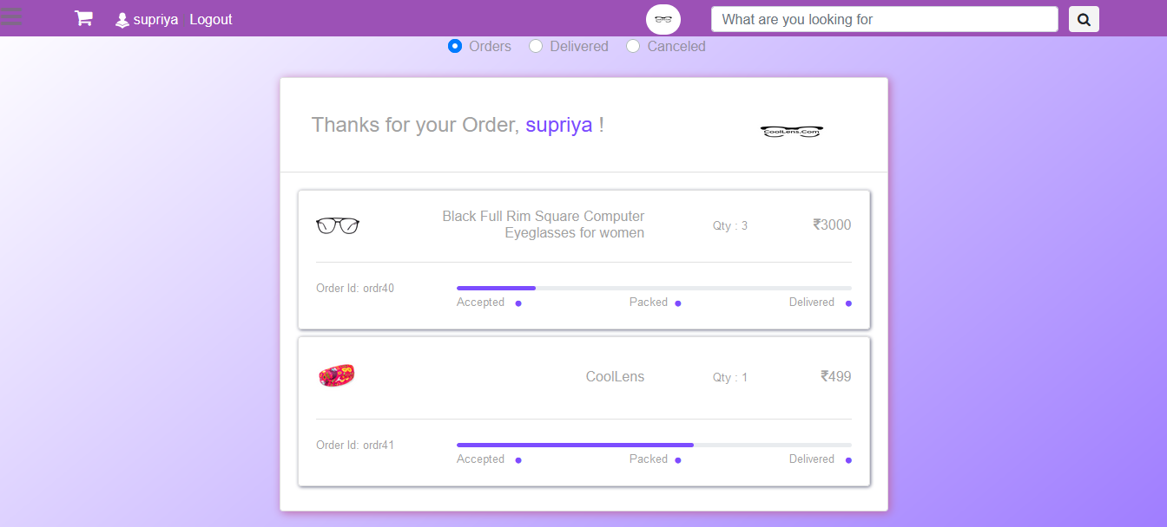
My order

Slide 91
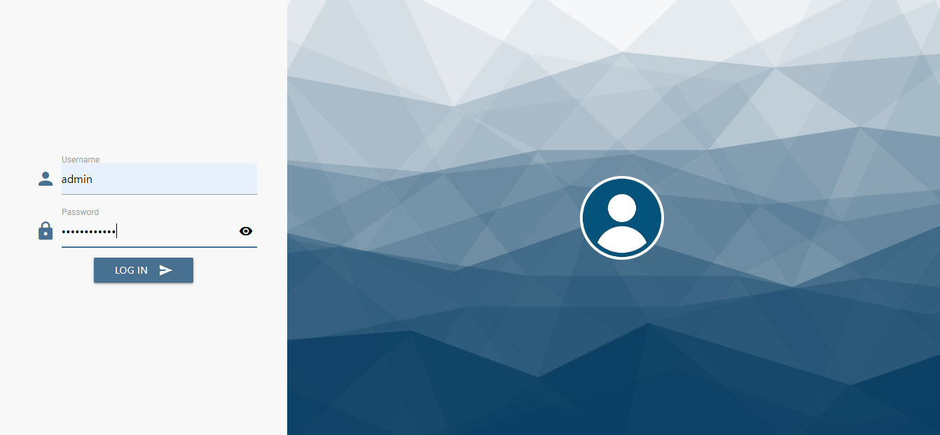
Admin Login

Slide 92
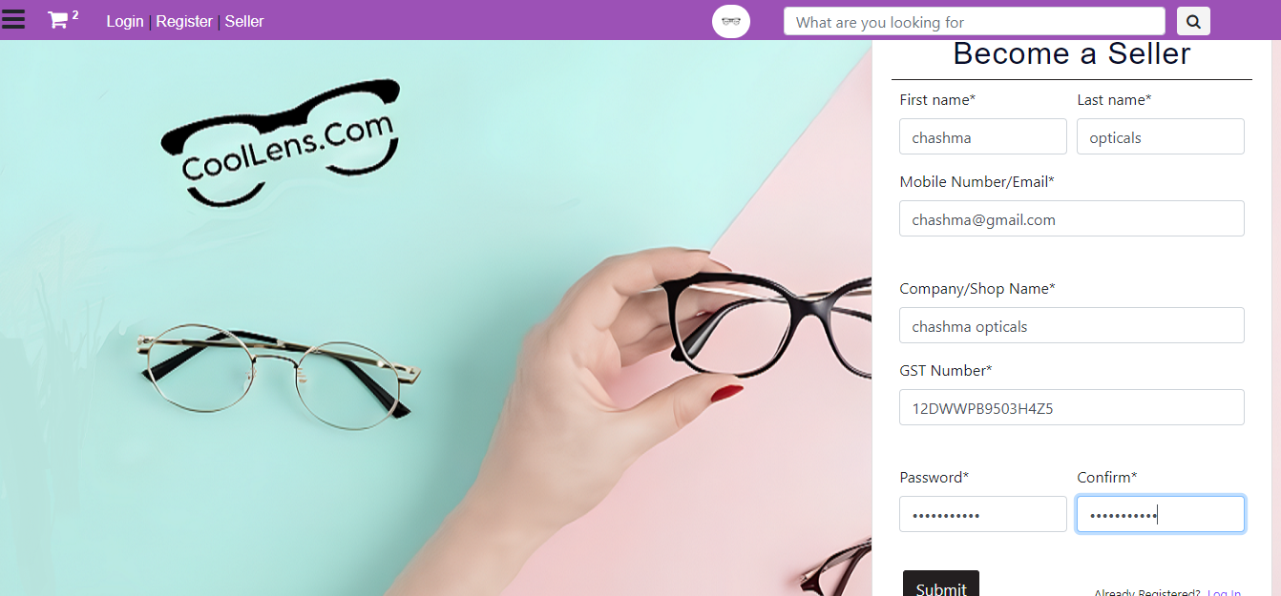
Seller registration

Slide 93
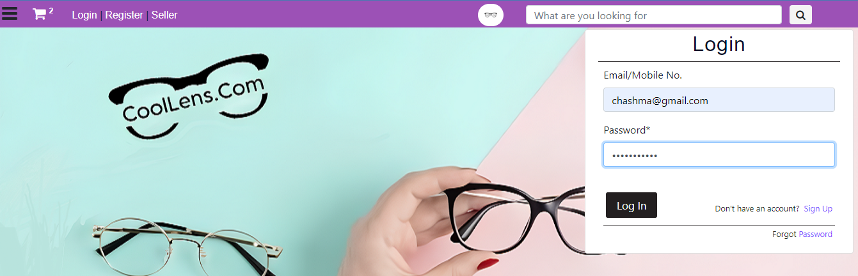
Seller login

Slide 94
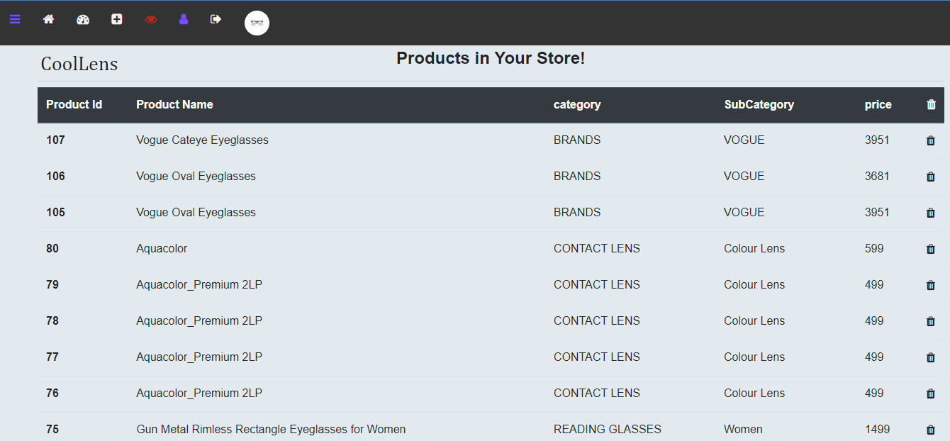
Products

Slide 95
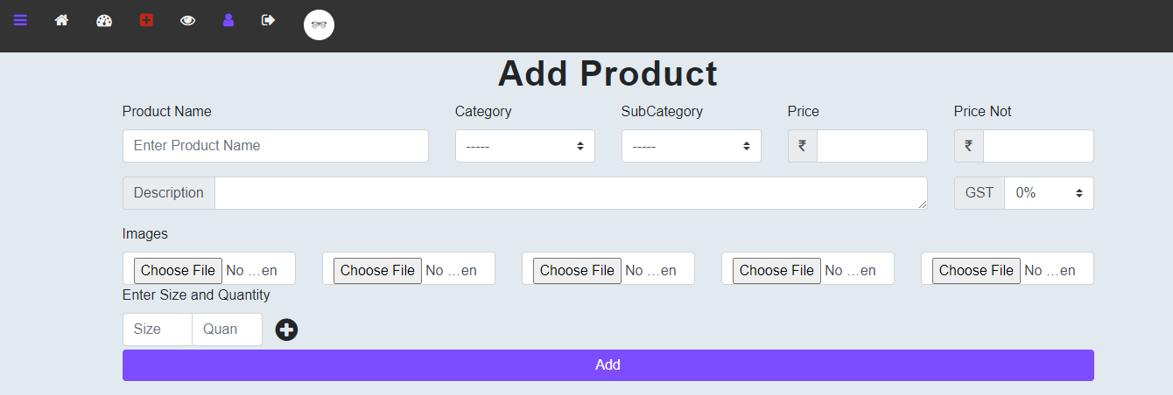
Add Product:

Slide 96
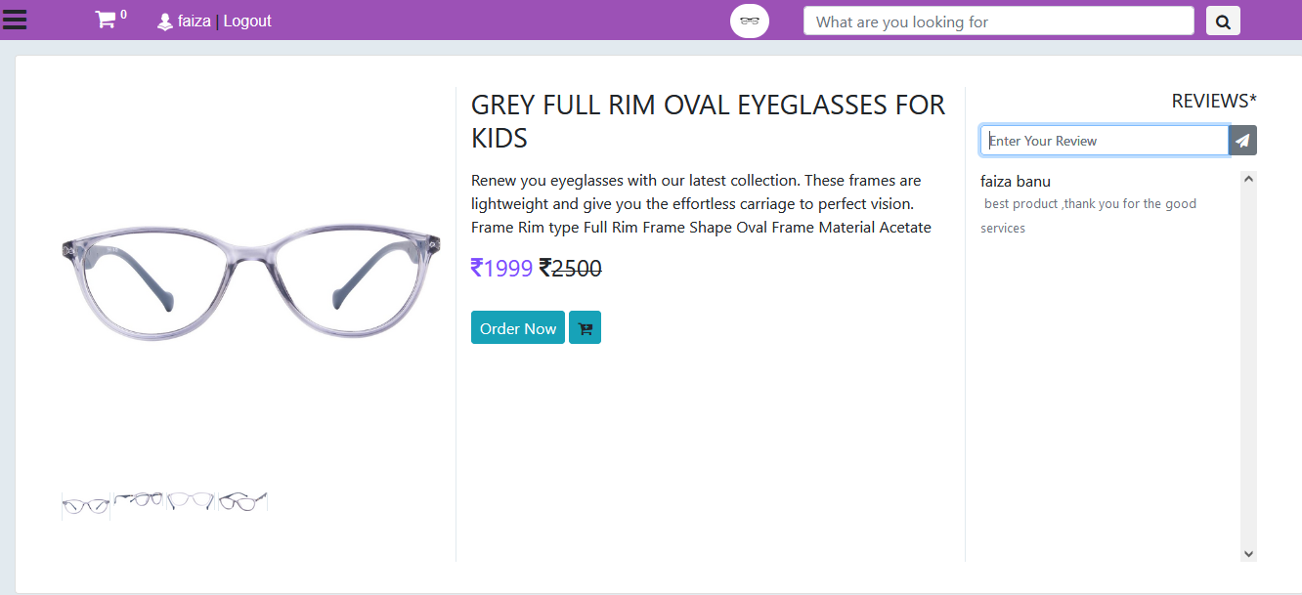
Feedback

Slide 97
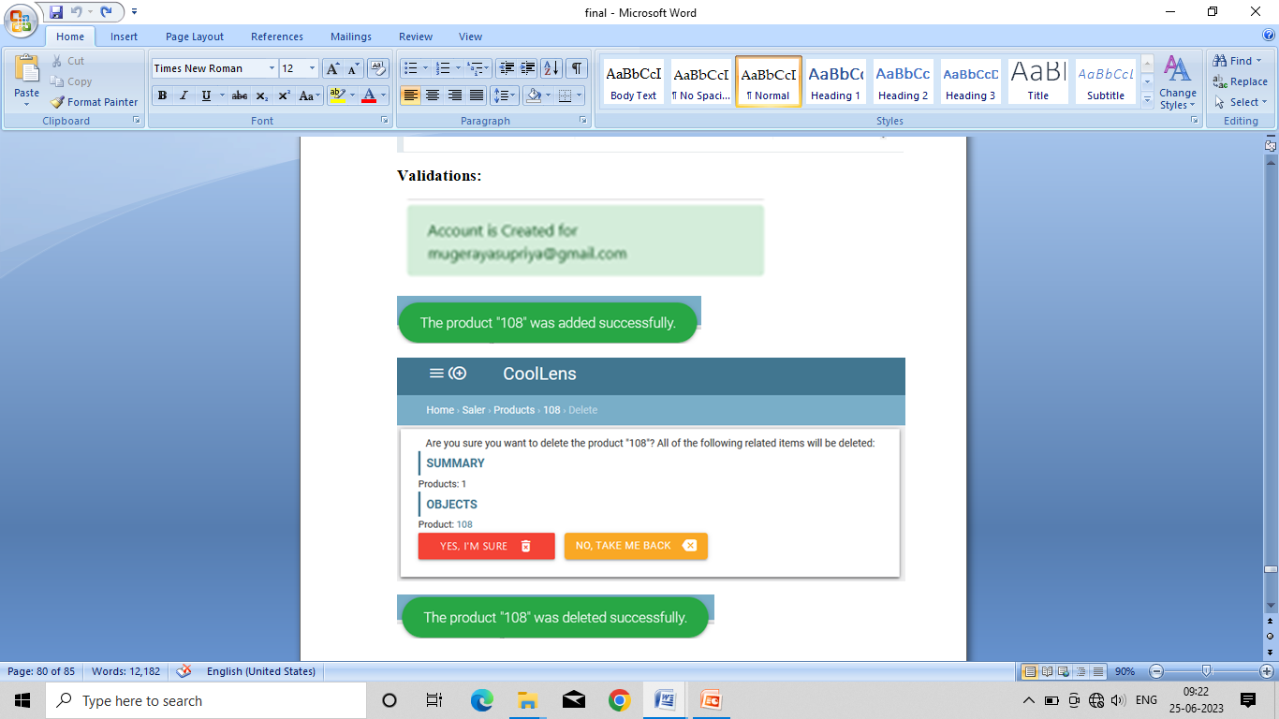

Slide 98
CONCLUSION

Slide 99
Chapter-10 Conclusion
The work titled “CoolLens” has been designed using Python with Django web framework where in many users friendly form control have been added in order to make it user interactive application. The system is developed in such a way that the user with common knowledge of computers can handle it easily.

Slide 100
LIMITATIONS

Slide 101
Chapter-11
Limitations
virtual try on
Real time payment gateway not working in the system.
Return and Exchange policy
Internet connection required

Slide 102
SCOPE FOR
ENHANCEMENT

Slide 103
Chapter-12 Scope for Enhancement
Future enhancements to the system can be made as technology changes. This includes the development and integration of mobile apps, as well as few additional features such as virtual try-on and an improved return and exchange policy.

Slide 104
BIBLIOGRAPHY

Slide 105
Chapter-14
Bibliography
YouTube reference:
Code artisians lab
Code with harry
Rajtosh Ranjan
Programming with Mosh
Book reference:
Software Engineering by Pankaj jalote
Abraham sliberschatz, Henry korth an s. sundarshan Data system concept
Python complete reference by Martin C. Brown, McGraw Hill Education
Dr.R. Nageshwara Rao, core Python Programming, Dreamtech Press, Second Addition

Slide 106
Web references:
JavaScript -
https://www.w3schools.com/js/default.asp
CSS -
https://www.w3schools.com/css/default.asp
http://www.tutorialspoint.com/css/index.html
HTML 5 –
http://www.tutorialspoint.com/html5/index.html
Python-
http://docs.python.org
Django-
http://www.djangoproject.com
Question and answer site:
www.stackoverflow.com

Slide 107
Thank you

